Slide 1


The Monica Bellucci Fanclub
Detection and Defense Lessons Learned from the Trickbot Forum

Slide 2





ME
Find cool detection rules at Red Canary
Seen Ransomware operators doing their thing a few times.
Air Force Cyber Warfare Operator (1B4)
Went to Italy for an Air Force thing, came back with only four bottles, should’ve gotten more.
I’m like a moth to a dumpster fire, i’m naturally drawn to badguy activity.
Jason Killam
Detection Engineer
RED CANARY
@killamjr

Slide 3
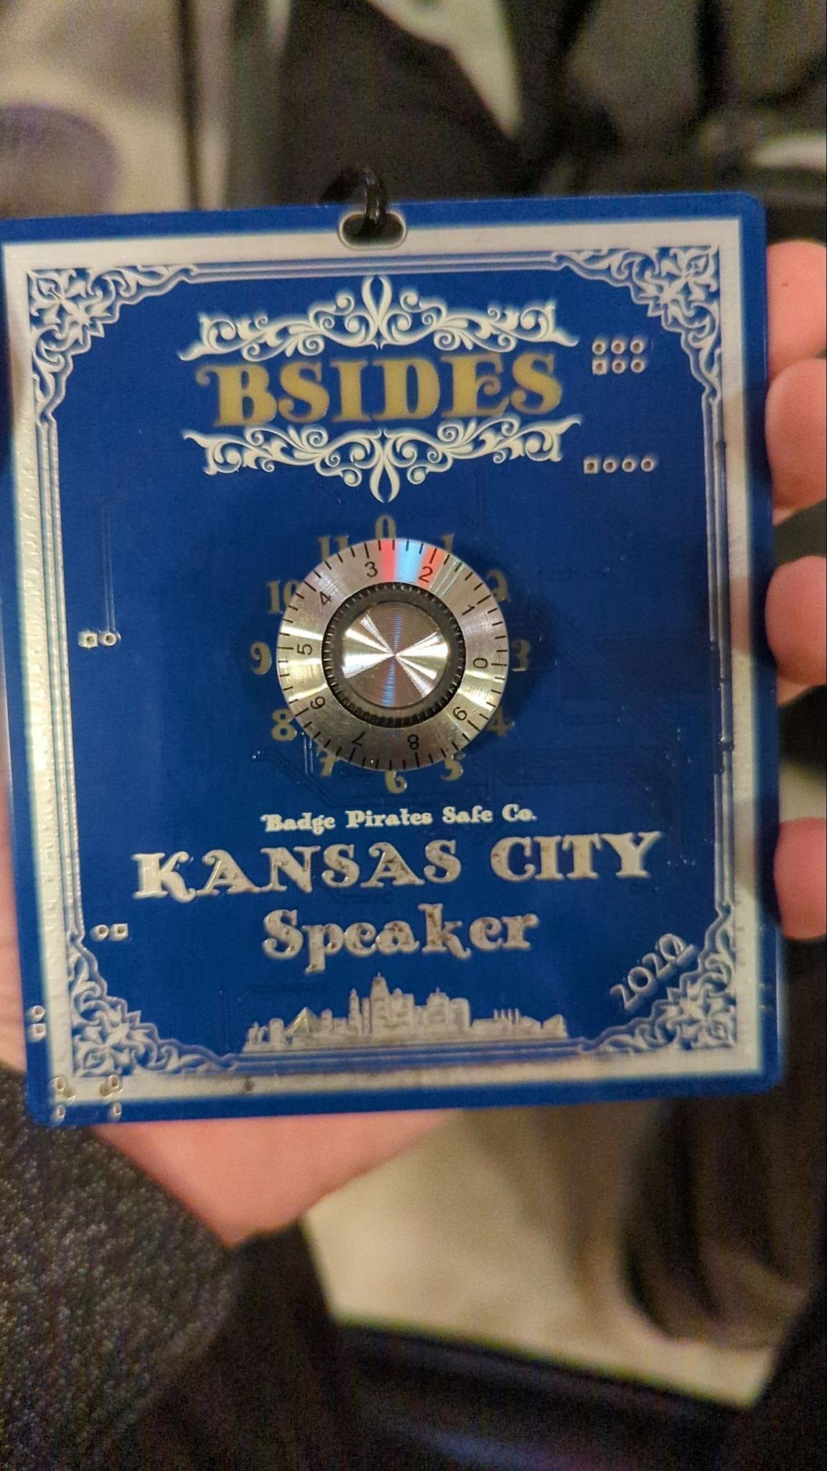

I just wanted to say I appreciated that the Badge Pirates made these badge to go to 11
10 is not enough

Slide 4


Detecting ALL THE THINGS is hard, but detecting these guys is easy
THING ONE
(With the right rules)

Slide 5
Overview - Trickbot Forum
This is the forums content from MY perspective as a Detection Engineer
Regardless of your job in InfoSec I’d highly recommend looking through yourself
I’m pretty sure a Red Teamer, Pentester, SOC Analyst, or someone working on policy level stuff could take away some interesting context as well
Conti/Trickbot have been disbanded, why bother looking at this stuff?
These guys scattered to other groups, so if you’ve got $badguy in your environment they’ll probably use some of these same tactics/tools

Slide 6
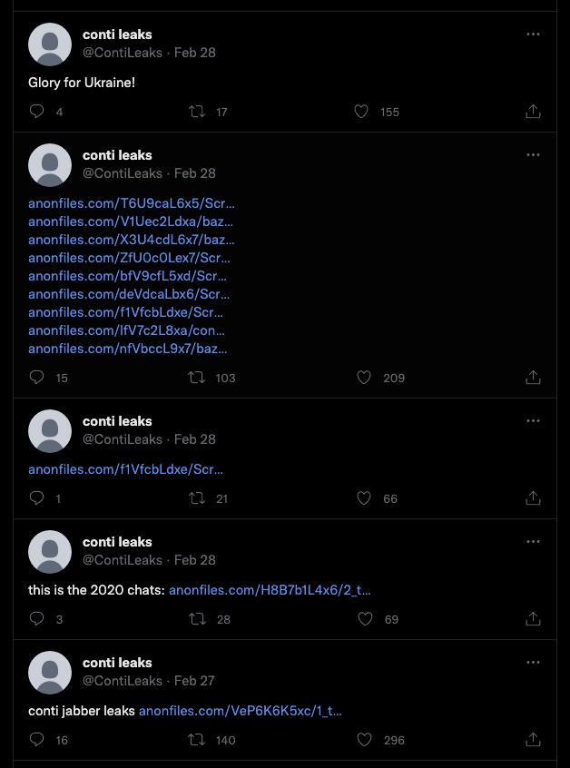
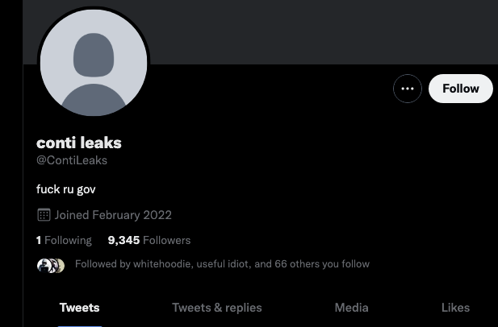
Situation
When Russia invaded Ukraine, a user named “ContiLeaks” dumped the several internal files, mostly internal chat server logs.
He did an interview with CNN, it appears he’s a former cyber security researcher
'I can fight with a keyboard': How one Ukrainian IT specialist exposed a notorious Russian ransomware gang - CNNPolitics

Slide 7
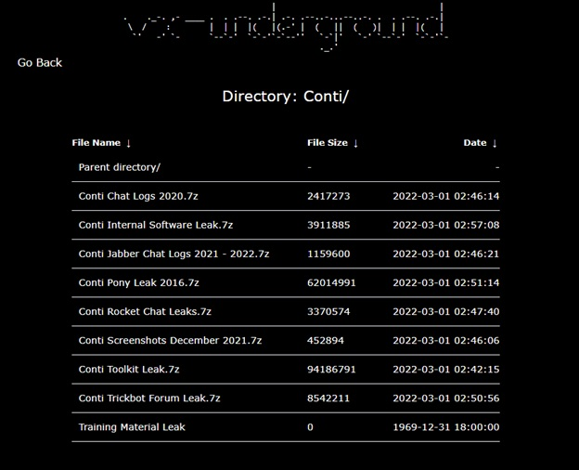
Overview - Trickbot Forum
Trickbot Forum Dumped Online
Everyone was talking about the chat logs
What about the forum?
The Forum Had What is Basically a “PlayBook”
Tools, with walkthroughs, command lines
Guides for priv escalation, exfil, etc

Slide 8
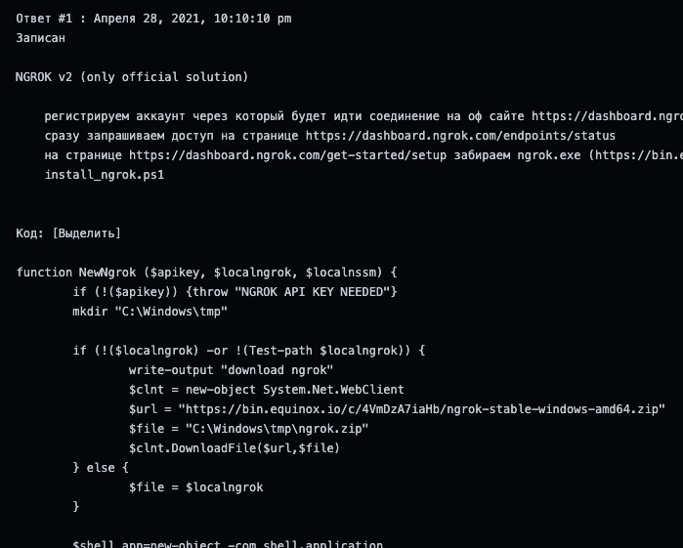
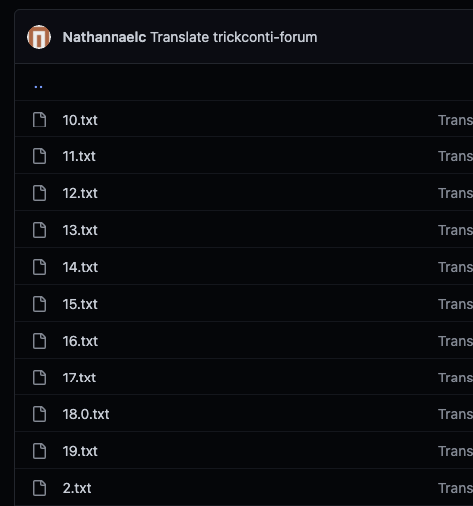
BUUUUUT It’s in Russian
And Split Across several text Files
Notes:
High Fidelity Telemetry
Collection A shortage of relevant attack data can leave the best security programs blind to imminent threats. Red Canary collects robust endpoint telemetry, including processes, file modifications, binary metadata, network connects and more. This deep visibility supports faster and more accurate detection, threat hunting, incident response and other activities.
Normalization Nonstandard and inconsistent data formats limit your ability to quickly analyze threat data. Red Canary automatically normalizes all telemetry data into a standardized format to deliver faster and more consistent analysis on all relevant endpoint data. No matter what endpoint monitoring you deploy, we’ll make sure that you get the most value out of your data.
Retention Whether you need it for auditing, to meet compliance requirements, or forensic analysis and threat hunting, long term access to your monitoring data is important. Red Canary delivers full access to all of your raw and normalized telemetry data for a full year, whenever you need it. This gives you access to low-cost, hassle-free storage and recovery that you can’t get anywhere else.
Portability No matter what the use case, you need telemetry data portability for use by any number of external solutions. Red Canary allows you to selectively export raw and/or normalized telemetry data to any destination. Your team and tools always have access to your data at any time for any reason.
Search Effective forensic investigations, incident response, threat hunting and other threat management activities require rapid access to any relevant data. Red Canary allows you to quickly and easily search your telemetry data to support any use case. This means you spend less time trying to find meaningful data and more time effectively using it to secure your environment.
Visualization Relying solely on text-based alarms and investigations is an inefficient process that limits your ability to see the bigger picture and slows down detection and response times. Red Canary delivers powerful contextual visualization with intuitive navigation to quickly identify broader attack patterns and trends. This makes it easier for you to see and understand what’s happening on your endpoints so that you can detect and respond to threats faster.

Slide 9
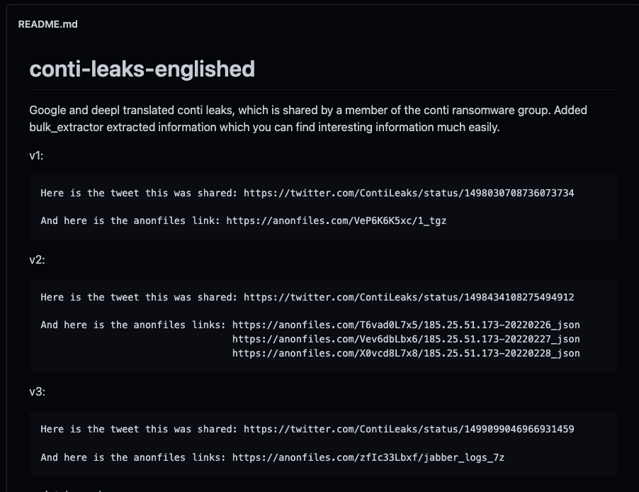

Enter Google Translate
Someone called “TheParmak” ran them through a translator API
https://github.com/TheParmak/conti-leaks-englished

Slide 10
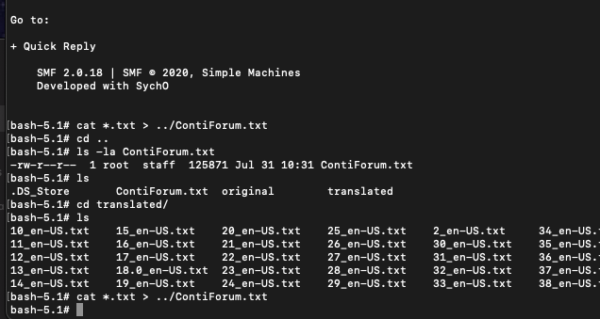

And Piping Things to Files :D

Slide 11

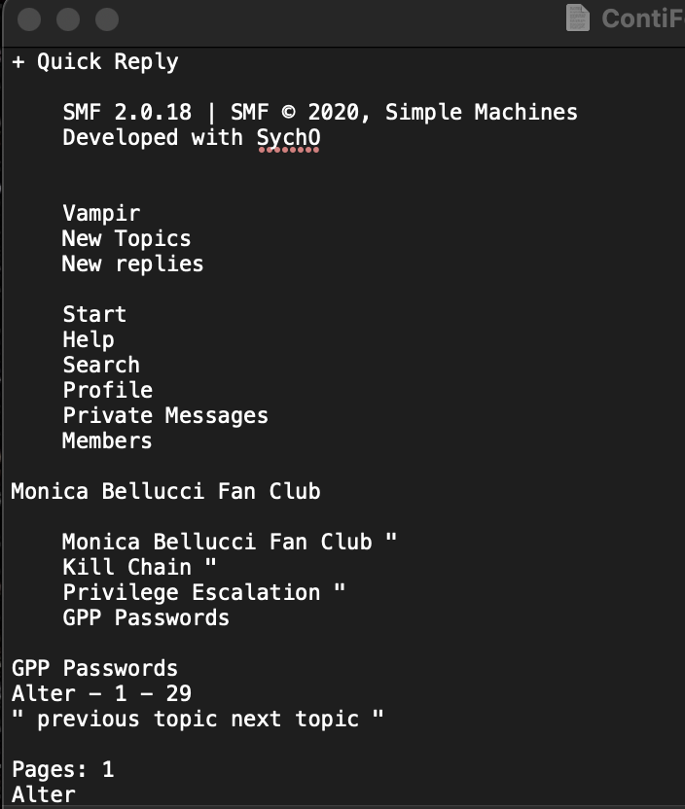
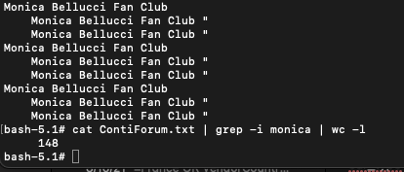
Who’s Monica Bellucci?
Some Italian Actress
Her Name is in the text of the Translated Forum
I think due to how the data was copied out of the forum
I had to delete her name a bunch of times, it drove me nuts

Slide 12
So what do they use?
A mixture of tools already on Windows (LoLBins)
NET, NLTEST, PowerShell (of course)
Lots of Traditional Red Team Tools - Cobalt Strike, Rubeus, Seatbelt, SharpChrome
Abused “sysadmin” tools, I don’t see these used much use by Red Teams
Rclone, ngrok, ADFind
Remote Access Tools
AnyDesk, Splashtop, Atera

Slide 13
LOLBINS - misc
NET Commands - Finding admins, Finding the Domain Controller
Nltest /dclist, is explicitly listed, but keep an eye out for /domain_trusts, /all_trusts /trusted_domains, and /whowill, as these commands are pretty rare.
And common for malware bots like QBot.

Slide 14
Sub-Drill.sh
Tool for Red Teams/Pentesters to find a target’s subdomains.
It’s not really clear to me what they would use this for if they’re already in the network, although I could see this being useful.
https://github.com/Fadavvi/Sub-Drill

Slide 15
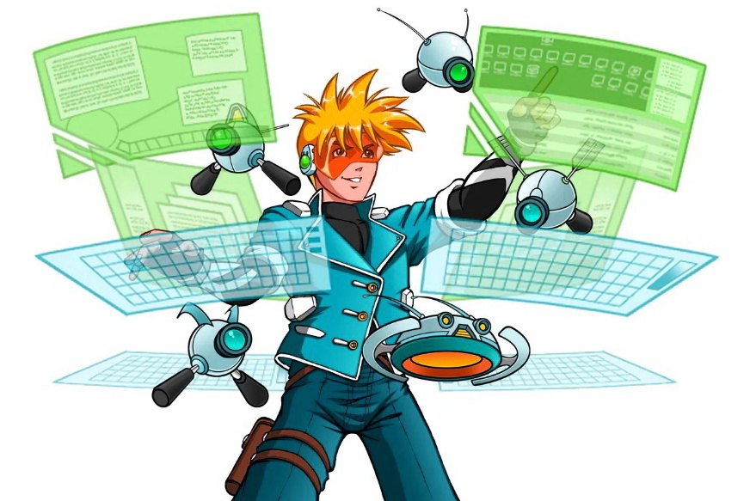

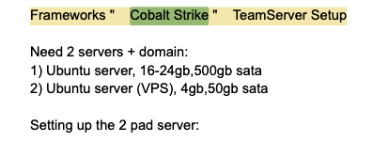
Cobalt Strike
An infamous penetration testing framework
A large portion of the stuff I went through was related to CS
How to setup a server
A lot of their command line examples used the CLI in the context of being on a beacon through CS (I think so at least)

Slide 16
Cobalt Strike cont’d
They also have a section about setting up a profile to make the C2 more stealthy.
They point to C2Concealer as their tool of choice (made by Forty North)
Personal experience from seeing CS a few times: they don’t always bother putting in this much effort.
They do randomize stuff, but recognizing the most common “defaults” can find a lot
Ref: Introducing C2concealer: a C2 Malleable Profile Generator for Cobalt Strike
Ref: Randomized Malleable C2 Profiles Made Easy

Slide 17
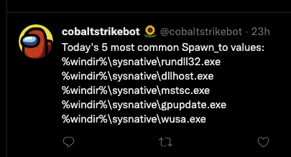
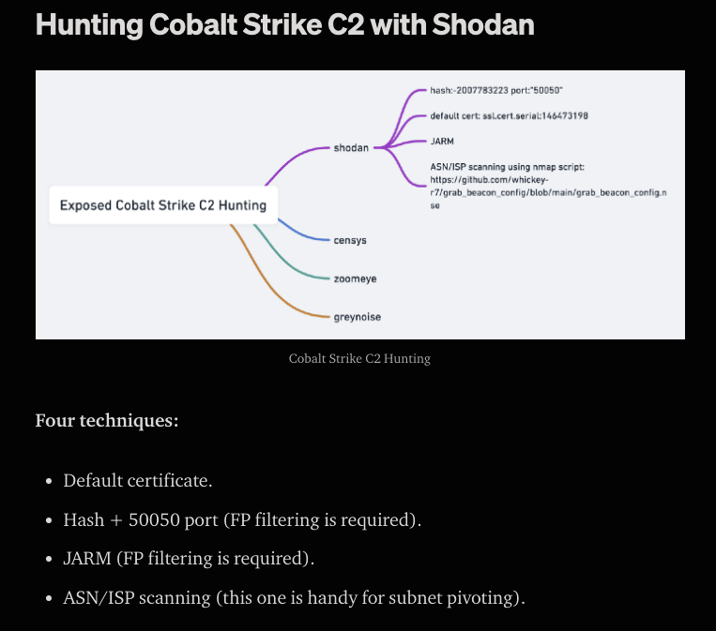
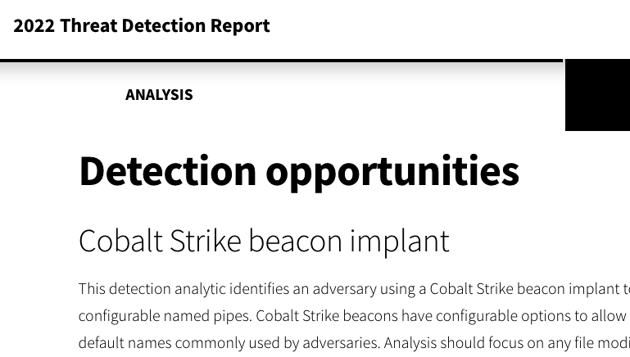
Cobalt Strike
cobaltstrikebot
Hunting Cobalt Strike C2 with Shodan | by Michael Koczwara | Medium
Cobalt Strike - Threat Detection Report - Red Canary

Slide 18

TOR
For those not aware TOR is a tool to help anonymize internet traffic.
The most common use is for web traffic, but Conti likes to use it to anonymize things the other way and use for anonymizing their inbound traffic.
Primarily used to anonymize SSH and RDP traffic with some corresponding netsh firewall rules.

Slide 19
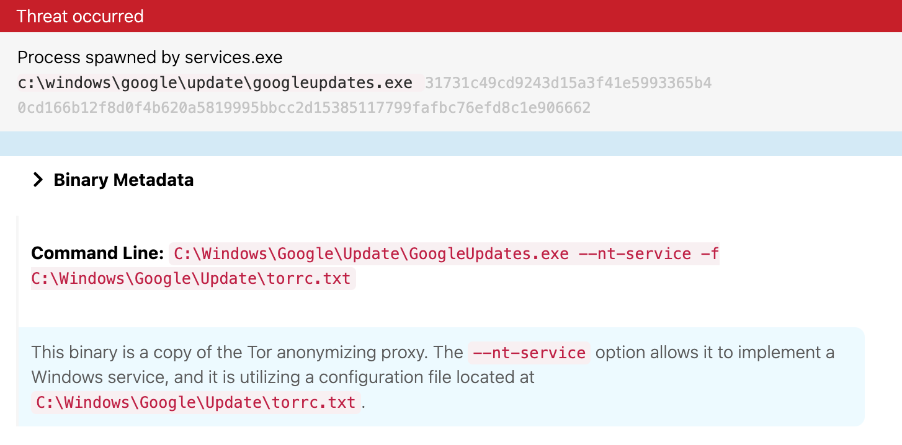
TOR

Slide 20
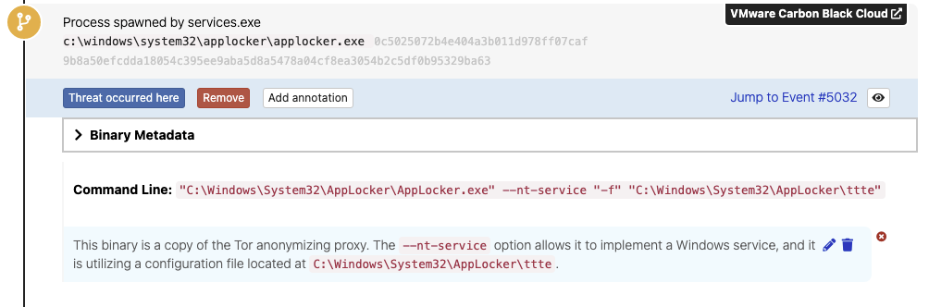
TOR - Detection Logic
Files renamed to TOR being written to \appdata\roaming\tor\ named 'state', 'lock', 'cached-microdesc-consensus' (not necessarily under the Users folder)
Command lines using the -f, option which will point to the TOR config file (usually named torrc)
https://manpages.debian.org/experimental/tor/tor.1.en.html

Slide 21
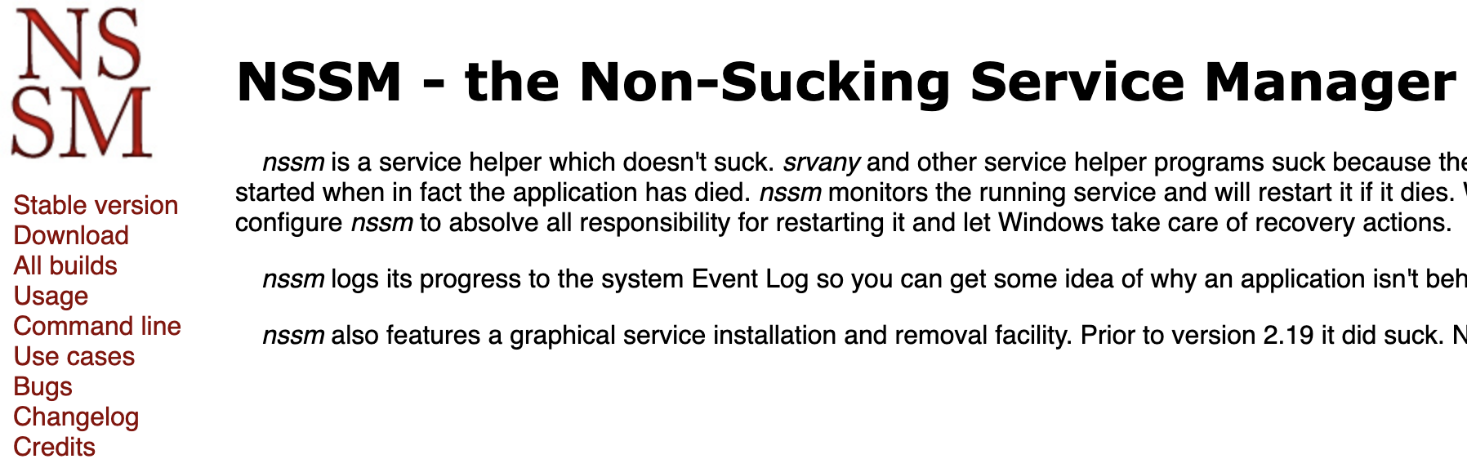
TOR/ngrok Backdoor Script
Download TOR/ngrok and nssm to windows\tmp, and rename tor to sysmon.exe
Use Not Sucking Service Manager (nssm) to create a service for TOR/ngrok binary.
Install SSH service and start both services
Create firewall rule to allow SSH

Slide 22
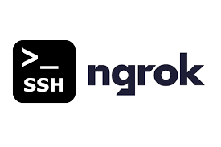
ngrok
This is a tool they like to use to setup easy reverse tunnels
Tool’s intended use is to easily host a server from within a network (usually a web server)
You can externally open any port you want (e.g. 3389 for RDP)
Normally named `ngrok.exe` but their documentation renames it to `sysmon.exe`
Look for network traffic to ngrok.io or ngrok.com “tcp” or “tunnel” domains.
https://ngrok.com/docs

Slide 23
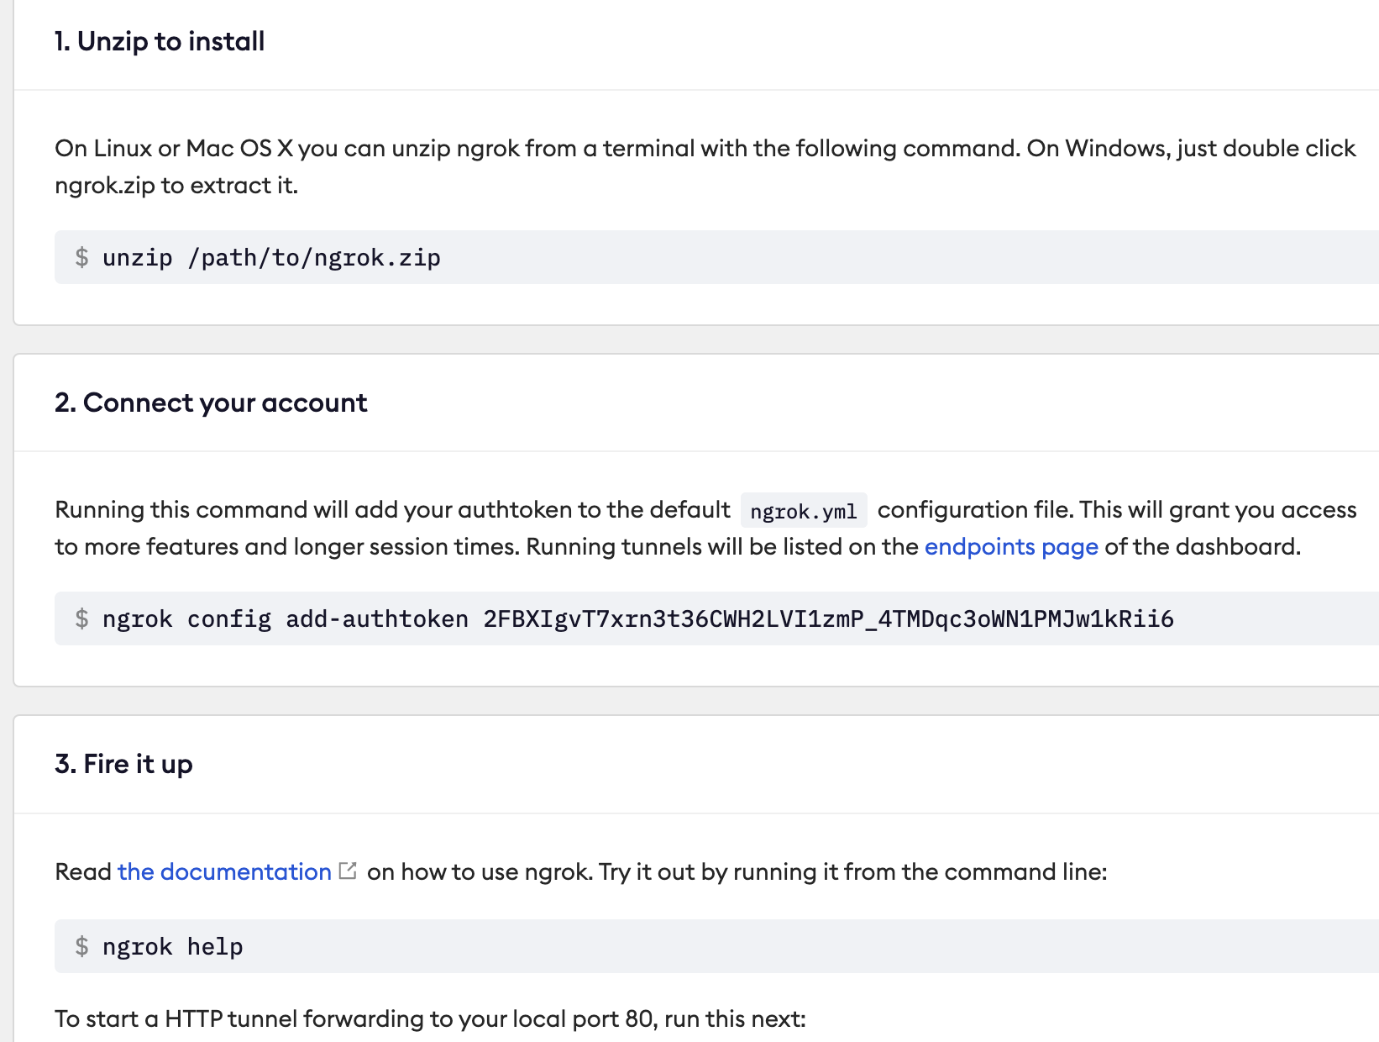
ngrok
Did I mention how easy this is to use?
https://dashboard.ngrok.com/get-started/setup

Slide 24
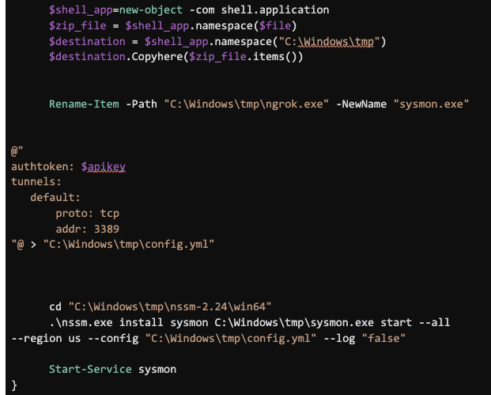
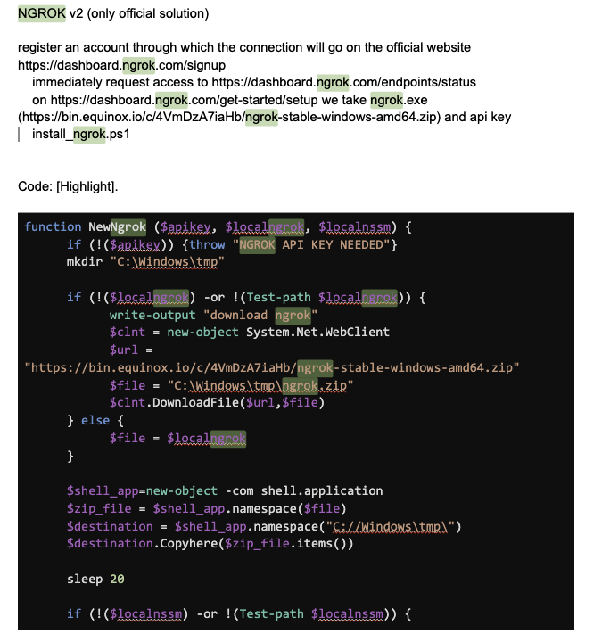
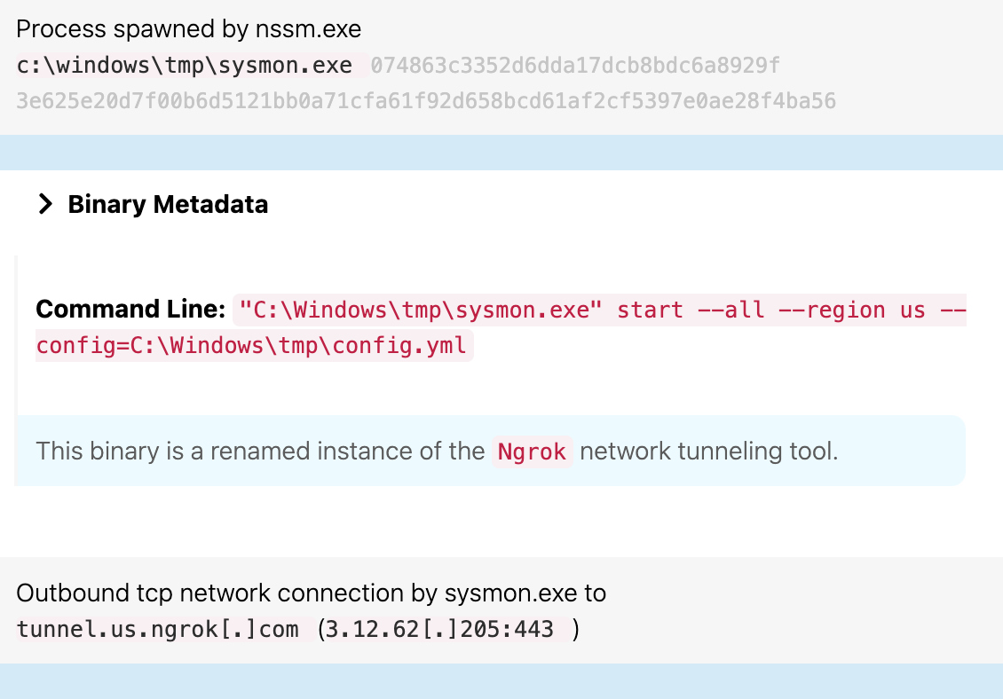
ngrok

Slide 25




Remote Access Tools
Their documentation mostly calls out using AnyDesk, but there are tons of possible options here.
Look for remote access tools that are not standard to your environment, or outside of their expected folders (e.g. program files).
Most “legit” RATs have accompanying network traffic to their creator for updates
Remote access tool or trojan? How to detect misbehaving RATs

Slide 26
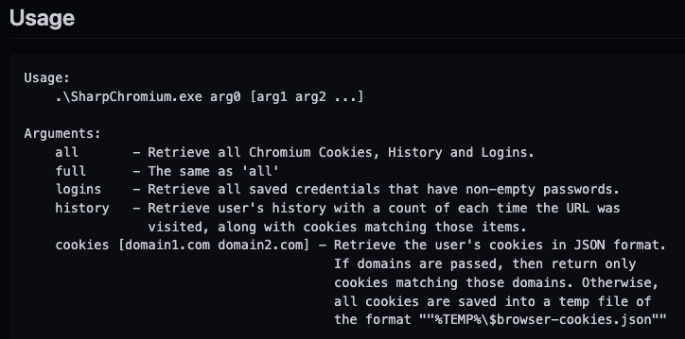

SharpChrome
SharpChrome basically a tool that lets them dump passwords and other credentials from chrome.
They’ll usually directly use these passwords, or use them as input into “Invoke-SMBAutoBrute”
https://github.com/djhohnstein/SharpChromium

Slide 27
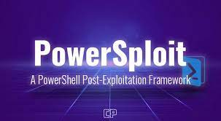
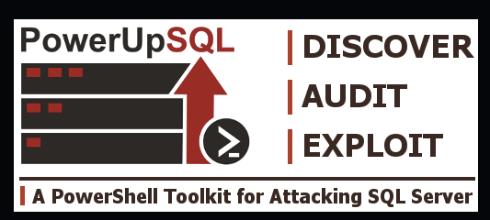

LOLBINS - PowerShell
PowerView - Invoke-ShareFinder
PowerView in general, helps an attacker with domain enumeration and recon.
Empire - Invoke-Kerberoast
Shellntel - Invoke-SMBAutoBrute
Conti seems to rely on this tool heavily when trying to find some new users to escalate/pivot into.
NetSPI - PowerUpSQL

Slide 28
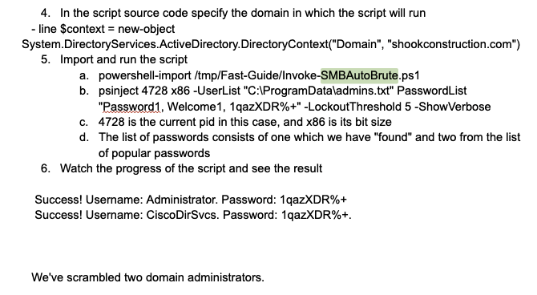
LOLBINS - PowerShell

Slide 29
Rubeus/Kerberoasting
Rubeus is a C# toolset for raw Kerberos interaction and abuses.
They use this to dump hashes for users to crack later in hashcat
They usually do this from an off-domain machine
You should still look for it on hosts
Good Red Canary Blogpost on kerberoasting - Marshmallows & Kerberoasting
https://github.com/GhostPack/Rubeus

Slide 30
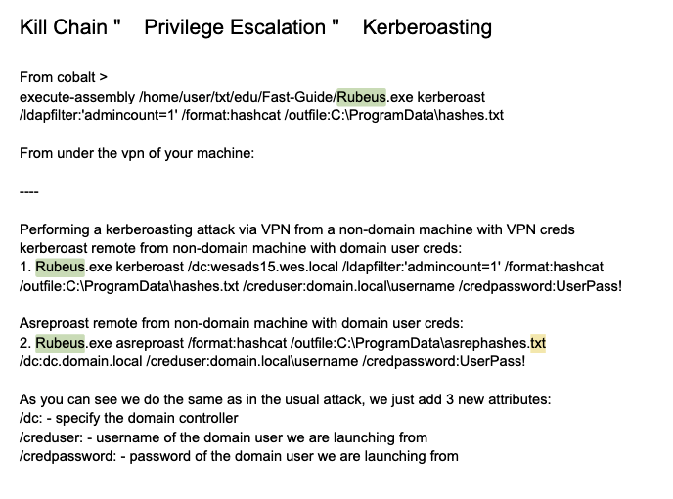
Rubeus/Kerberoasting

Slide 31
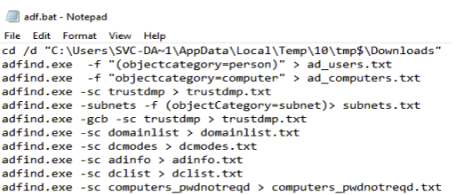
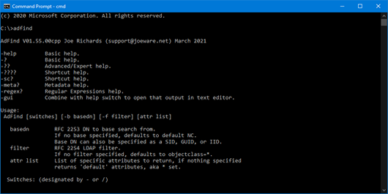
ADFind
Command line Active Directory query tool.
Their guides around commands to use and parsing it’s output are extensive.
Usually one of the first tools I see with QBot and other droppers
https://thedfirreport.com/2020/05/08/adfind-recon/
https://www.joeware.net/freetools/tools/adfind/

Slide 32
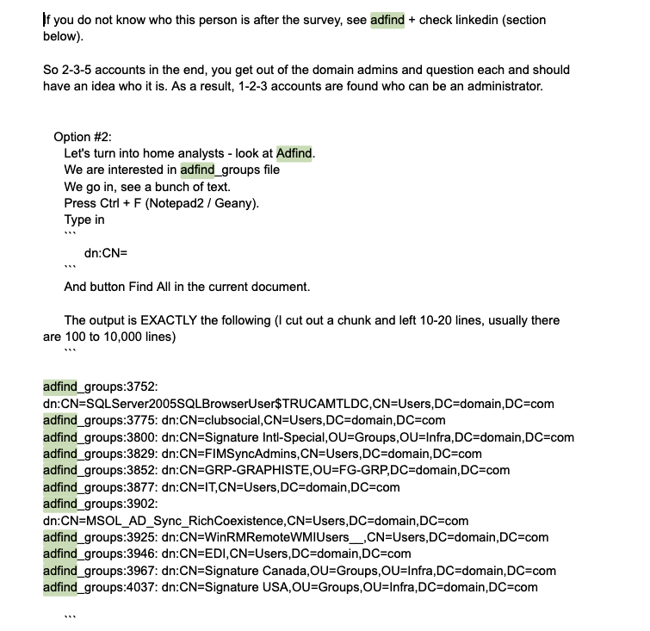
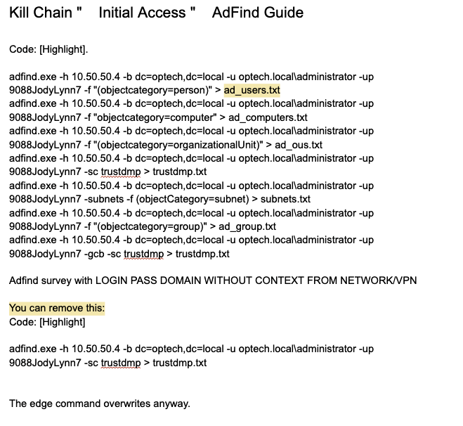
ADFind
https://www.joeware.net/freetools/tools/adfind/

Slide 33


SeatBelts Everyone!
Seatbelt is a C# project that performs a number of security oriented host-survey "safety checks" relevant from both offensive and defensive security perspectives.
This basically outputs tons of stuff useful for recon, privilege escalation, and possible credential theft opportunities.
Seatbelt.exe -group=all -outputfile="C:\ProgramData\seatinfo.txt"

Slide 34
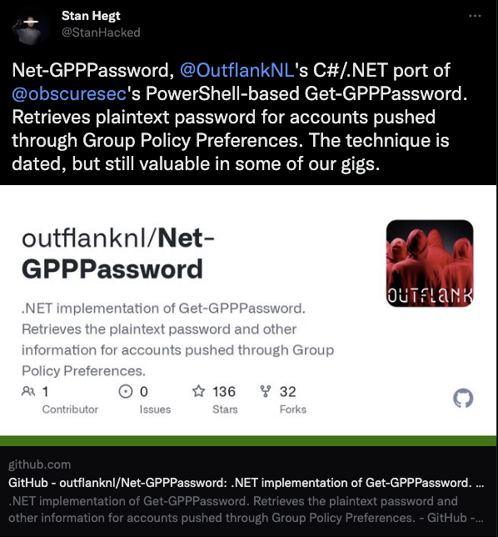
Net-GPPassword
Retrieves the plaintext password and other information for accounts pushed through Group Policy Preferences.
The version they use is a stand alone binary, but the original is a powershell script that’s part of powersploit.
https://github.com/PowerShellMafia/PowerSploit/blob/master/Exfiltration/Get-GPPPassword.ps1
https://github.com/outflanknl/Net-GPPPassword

Slide 35
SharpView
SharpView is a port of PowerView and they seem to use it in combination with `Find-DomainUserLocation` among other tools.
In general, it seems like a useful tool for a pentester to PWN a domain connected network with several tools.
https://github.com/tevora-threat/SharpView

Slide 36
ZeroLogon Tool
This appears to be a tool that exploits CVE-2020-1472.
They point the tool at the Domain Controller and use it to execute a command against it.
This vulnerability allows an unauthenticated attacker with network access to a domain controller.
CrowdStrike Ref: Zerologon (CVE-2020-1472): Overview, Exploit Steps and Prevention

Slide 37
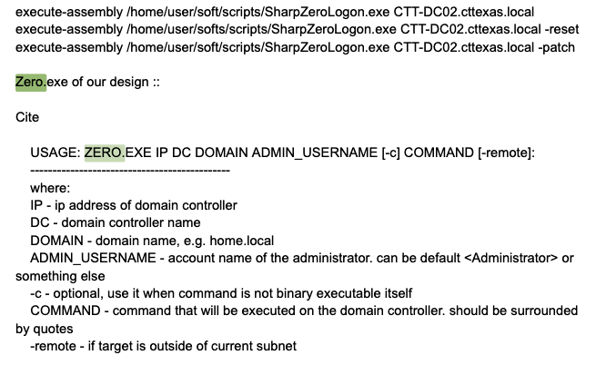
ZeroLogon Tool

Slide 38
Sneaky Registry Hacks
CurrentVersion\Winlogon\SpecialAccounts\Userlist
Adding Users to this list makes them “invisible” from the logon screen
CurrentControlSet\Control\Terminal Server\WinStations\RDP-Tcp
Change the default port RDP works on (with firewall rule)

Slide 39
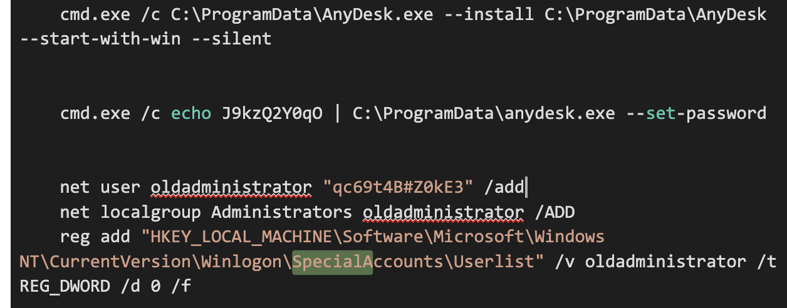
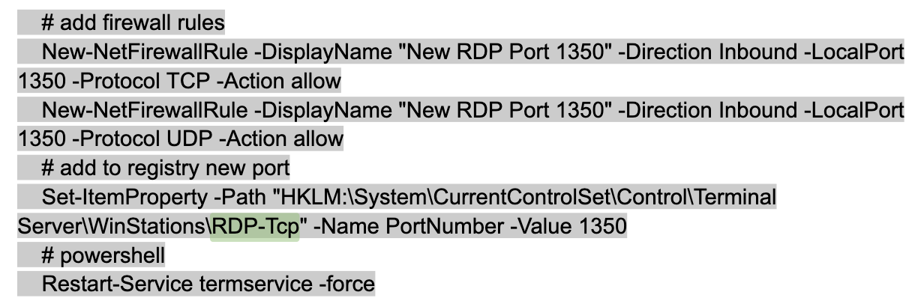

Slide 40
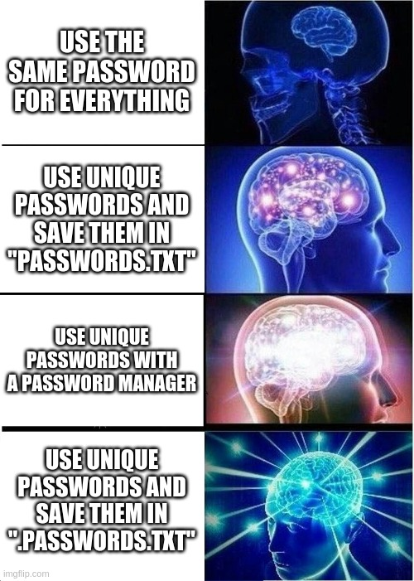
Privilege Escalatin’
Conti seems to prefer a much simpler path than you would expect
Find an admin user using net/ADFind
Using SharpView, find a workstation they use
Remote to their workstation via SMB shares with pass-the-hash and Cobalt Strike
Look through folders for Browser Cred Stores, password managers, and text files on the desktop (seriously).

Slide 41
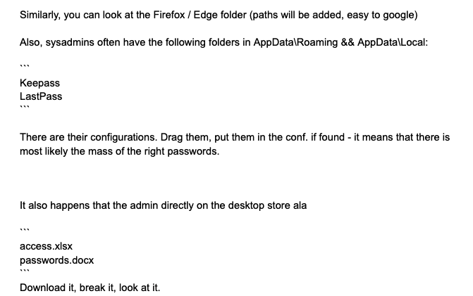
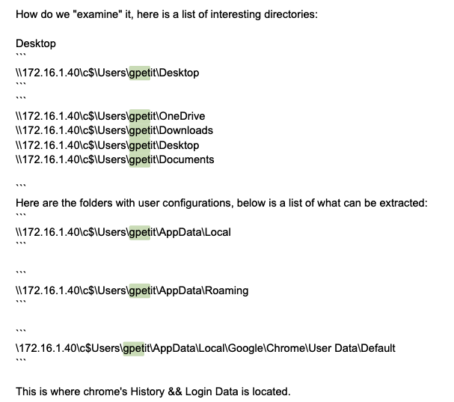
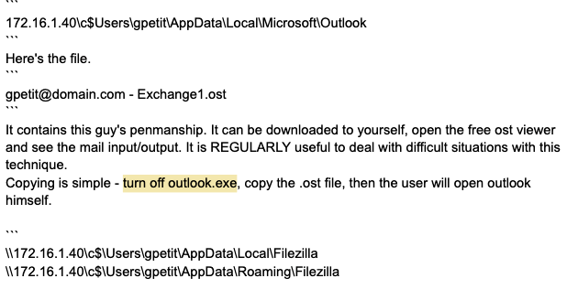
Privilege Esc. - Cont

Slide 42

NTDS Dumping
NOW WHAT?
Couple different ways
ntdsutil "ac i ntds" "ifm"
Enable Shadow Copies -> find shadows via vssadmin -> copy out ntds.dit
When an attacker has the NTDS.dit file, it’s like capture the flag, they’ve got what they want but they still need to get it home.
Exfil usually by zipping it or sometimes just copy the .dit file.
If you see this happen you need to reset the domain controller’s krbtgt TWICE.
Otherwise an attacker can make a golden ticket and come right back.

Slide 43
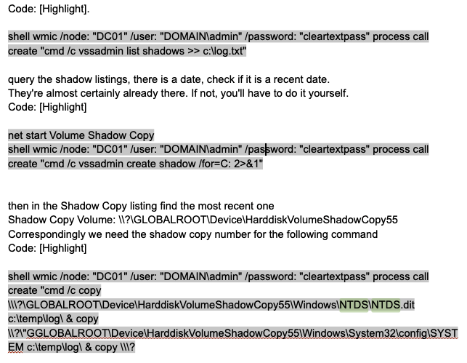
NTDS Dumping

Slide 44

FileZilla
Filezilla is super common tool admins and evil doers alike to use to access “File Shares”.
The Conti crew appears to use this tool by mapping a victim’s endpoint to their machine and allowing them to browse the file system at their leisure.
An interesting parallel I think about: during my time as a SOC worker, having the ability to browse a target user’s computer is a pretty easy way to access files of interest.

Slide 45
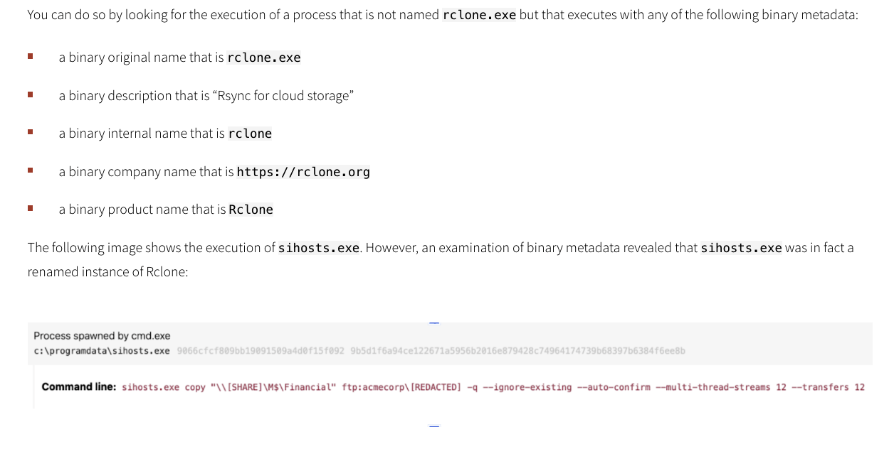
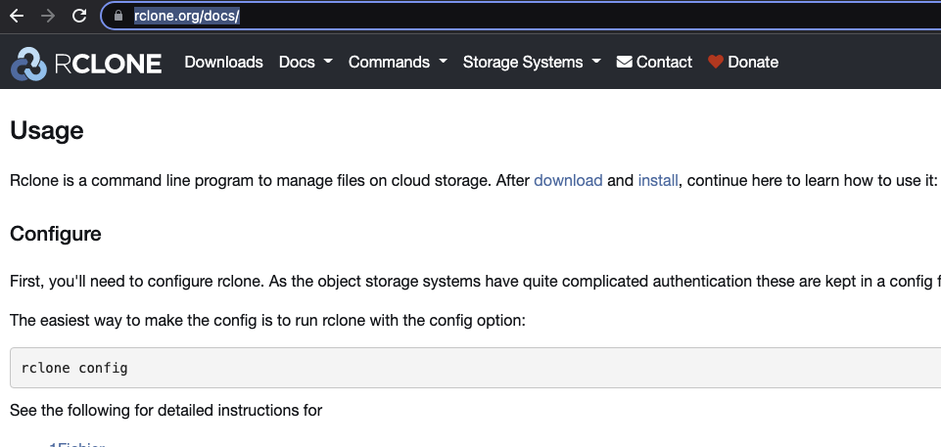
RClone
This is a tool similar to RSync, and makes it easy to copy data out of the network for backup exfil.
Justin and Aaron put out a great post on how they use this tool.
Rclone Wars: Transferring leverage in a ransomware attack

Slide 46
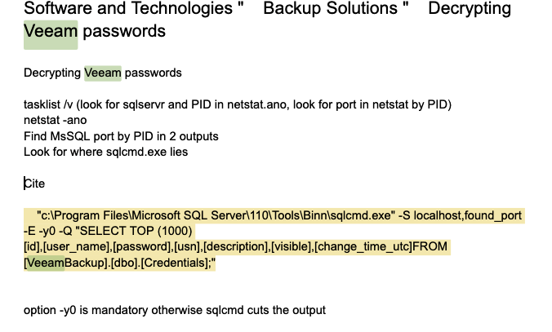

Decrypting Veeam Passwords
Veeam is a commercial product that’s often used to backup virtual machines.
Conti seems to run a SQL command specific to the Veeam platform.
Then use some .NET code compiled on site to extract the passwords so they can wipe out backups.

Slide 47

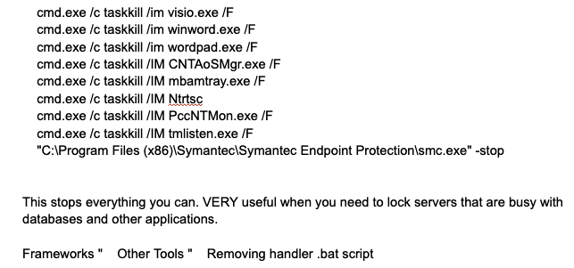

Stop ALL THE THINGS
Script to stop all the processes.
Cause they wanna encrypt all the things that’s why.

Slide 48


Summary
RTFM! - you can learn a lot of context from reading the
documentation on how some of these tools work
Gone but not forgotten - Conti is “disbanded” but almost all of these tools and tactics can be seen in some form today
Know normal find evil - learn what’s “normal” for your environment, do your sysadmins use Impacket, RClone, ADFind, or NetSupport?
0 Zero days - most of the tools they use don’t even exploit vulns

Slide 49
Q & A
FEEDBACK

